Slide 1
CS639: Data Management for Data Science
Lecture 17: Linear Classifiers and Support Vector Machines
Theodoros Rekatsinas
(lecture by Ankur Goswami many slides from David Sontag)

Slide 2
Today’s Lecture
Linear classifiers
The Perceptron Algorithm
Support Vector Machines

Slide 3
Linear classifier
Let’s simplify life by assuming:
Every instance is a vector of real numbers, x=(x₁,…,x_{n}). (Notation: boldface x is a vector.)
There are only two classes, y=(+1) and y=(-1)
A linear classifier is vector w of the same dimension as x that is used to make this prediction:

Slide 4
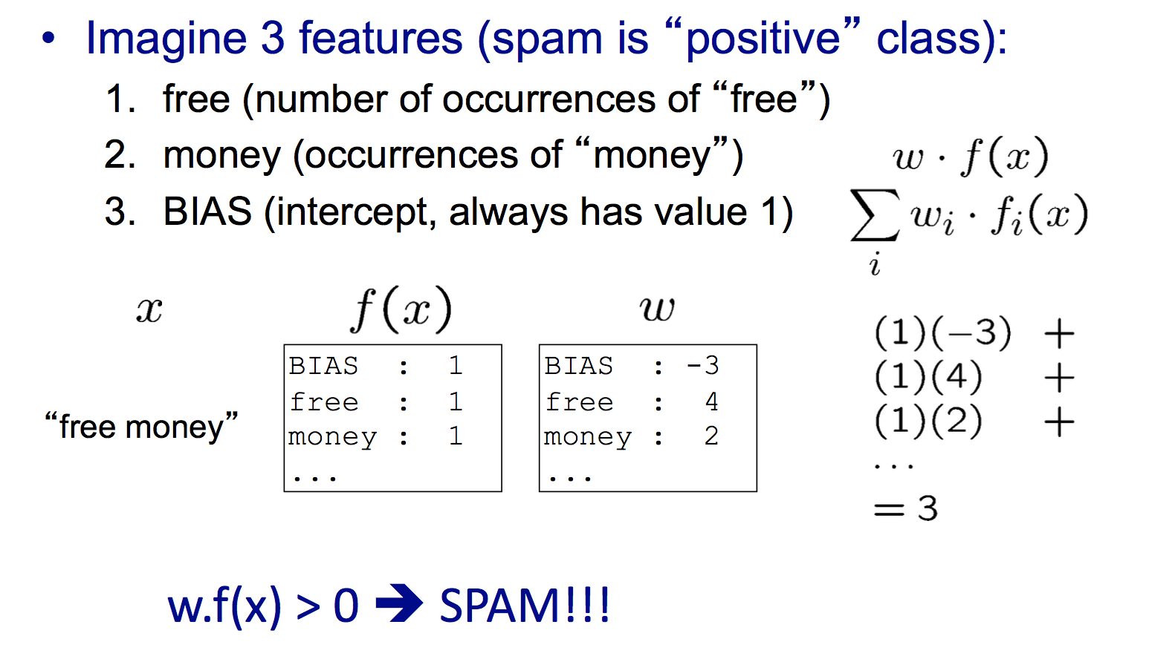
Example: Linear classifier

Slide 5
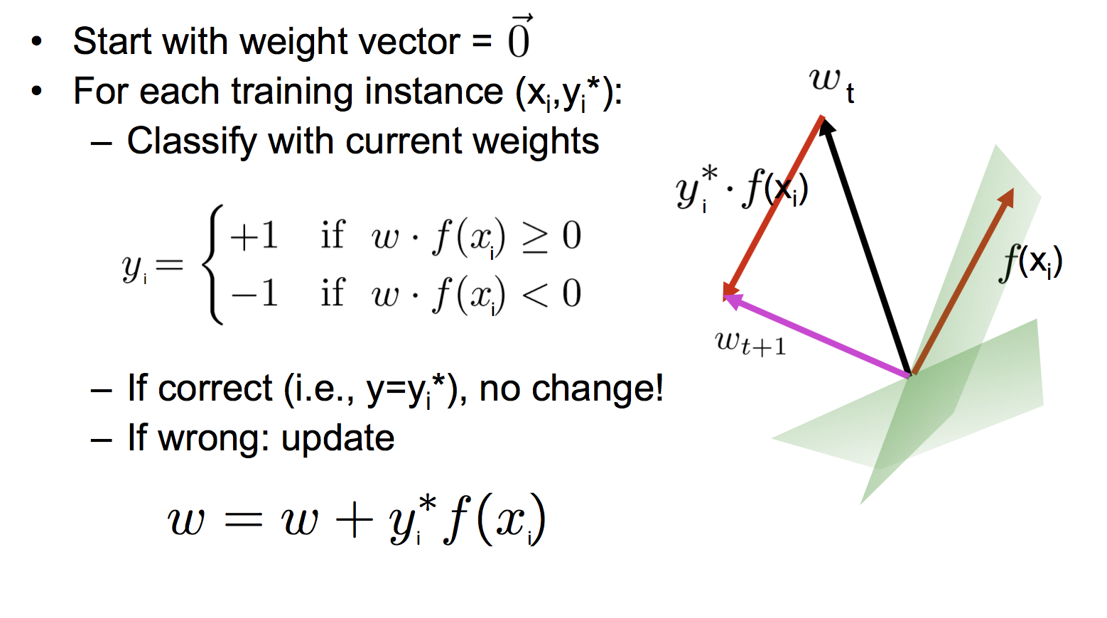
The Perceptron Algorithm to learn a Linear Classifier

Slide 6
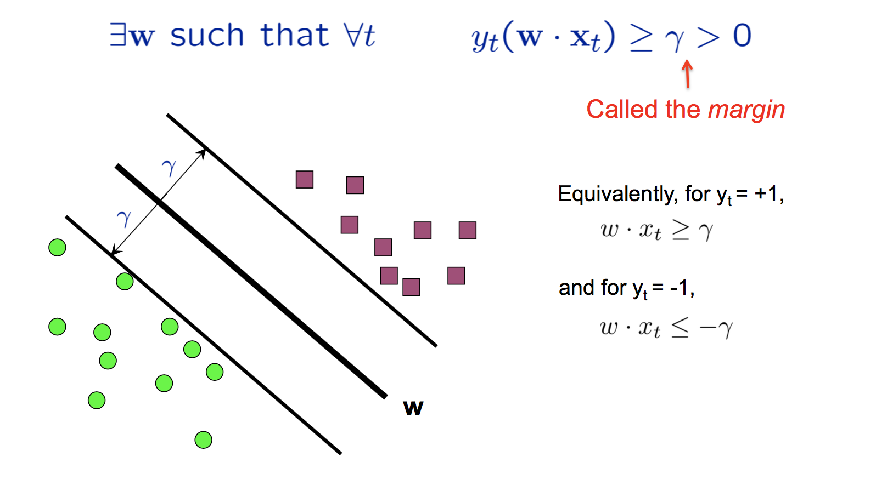
Definition: Linearly separable data

Slide 7
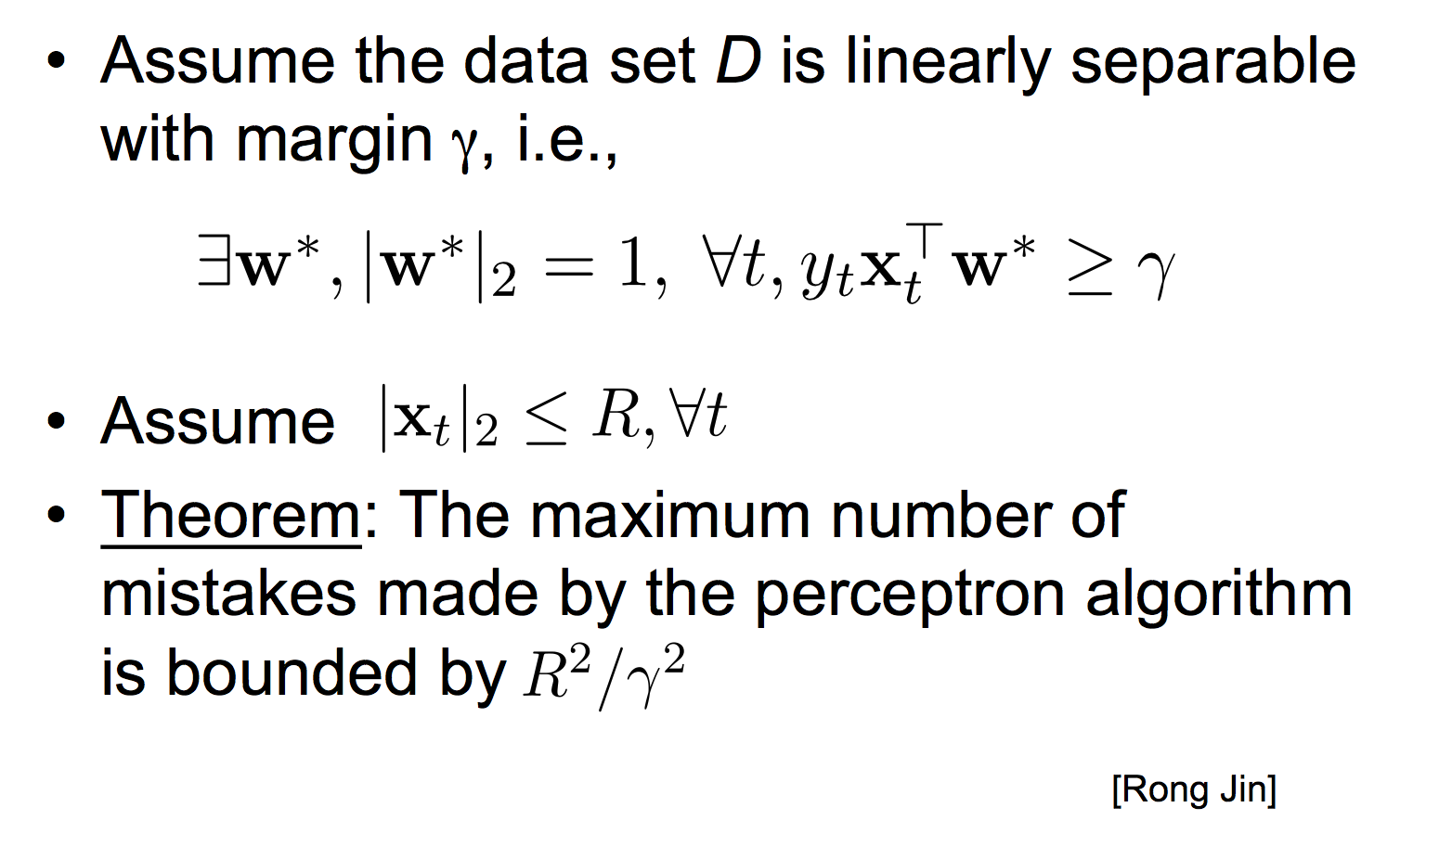
Does the perceptron algorithm work?

Slide 8
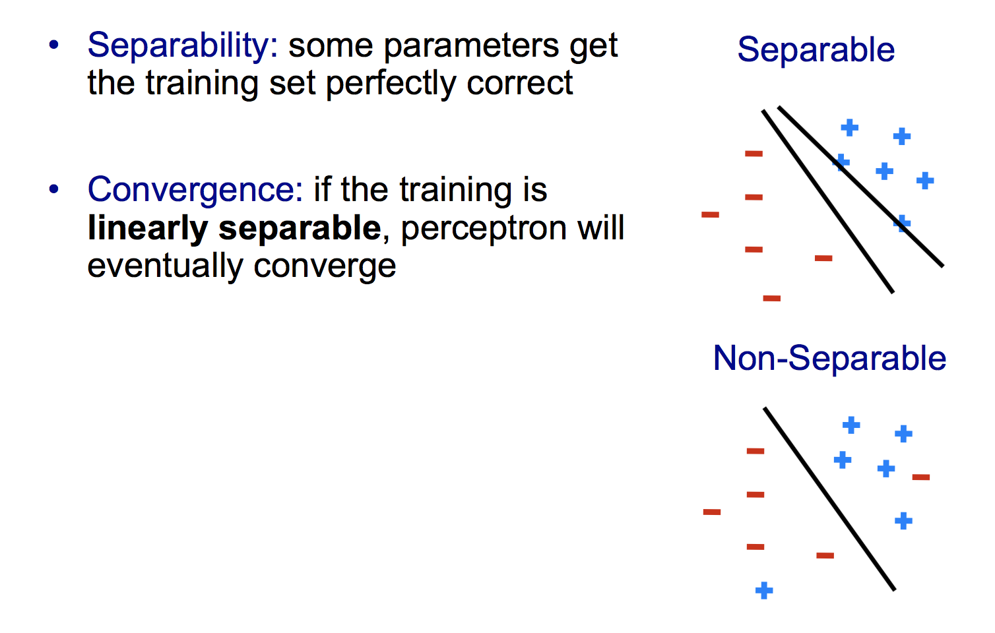
Properties of the perceptron algorithm

Slide 9
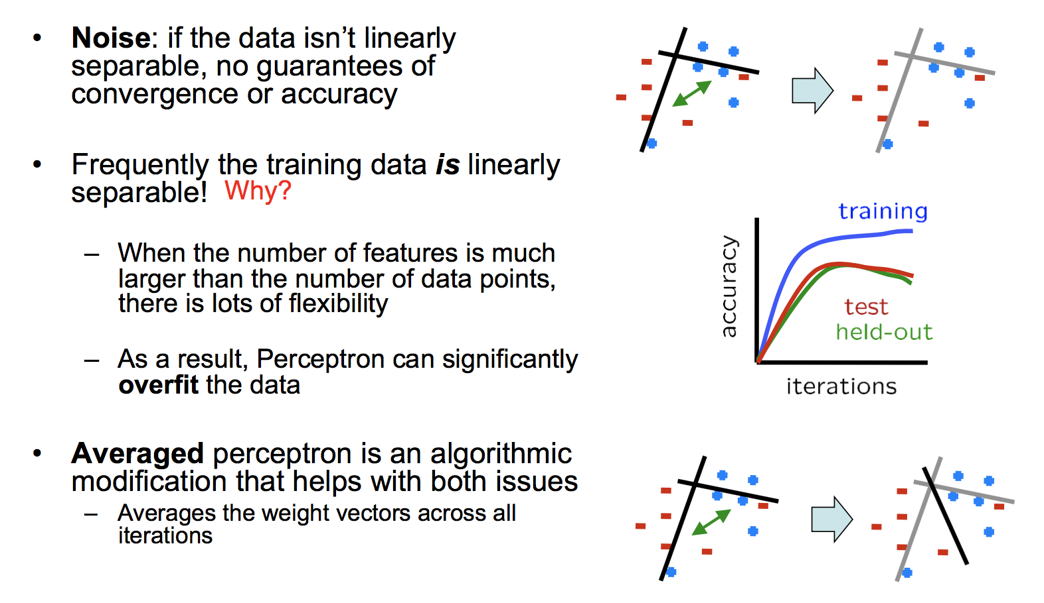
Problems with the perceptron algorithm
[We will see next week]

Slide 10
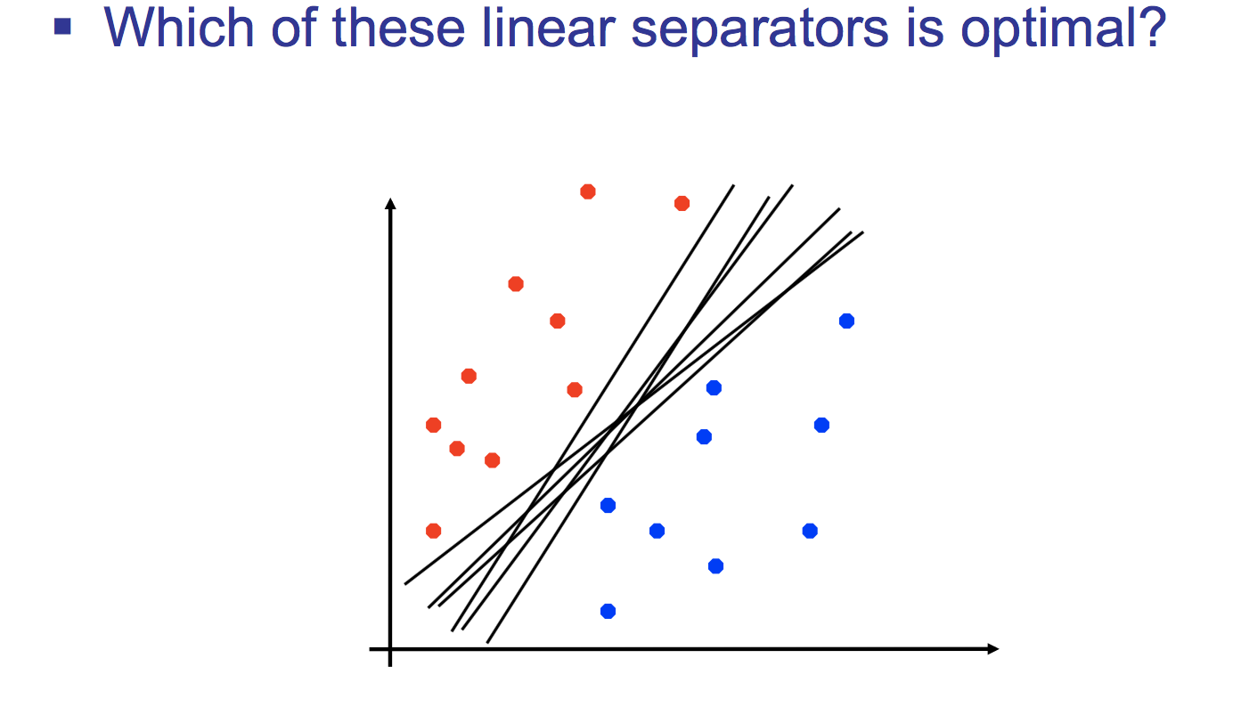
Linear separators

Slide 11
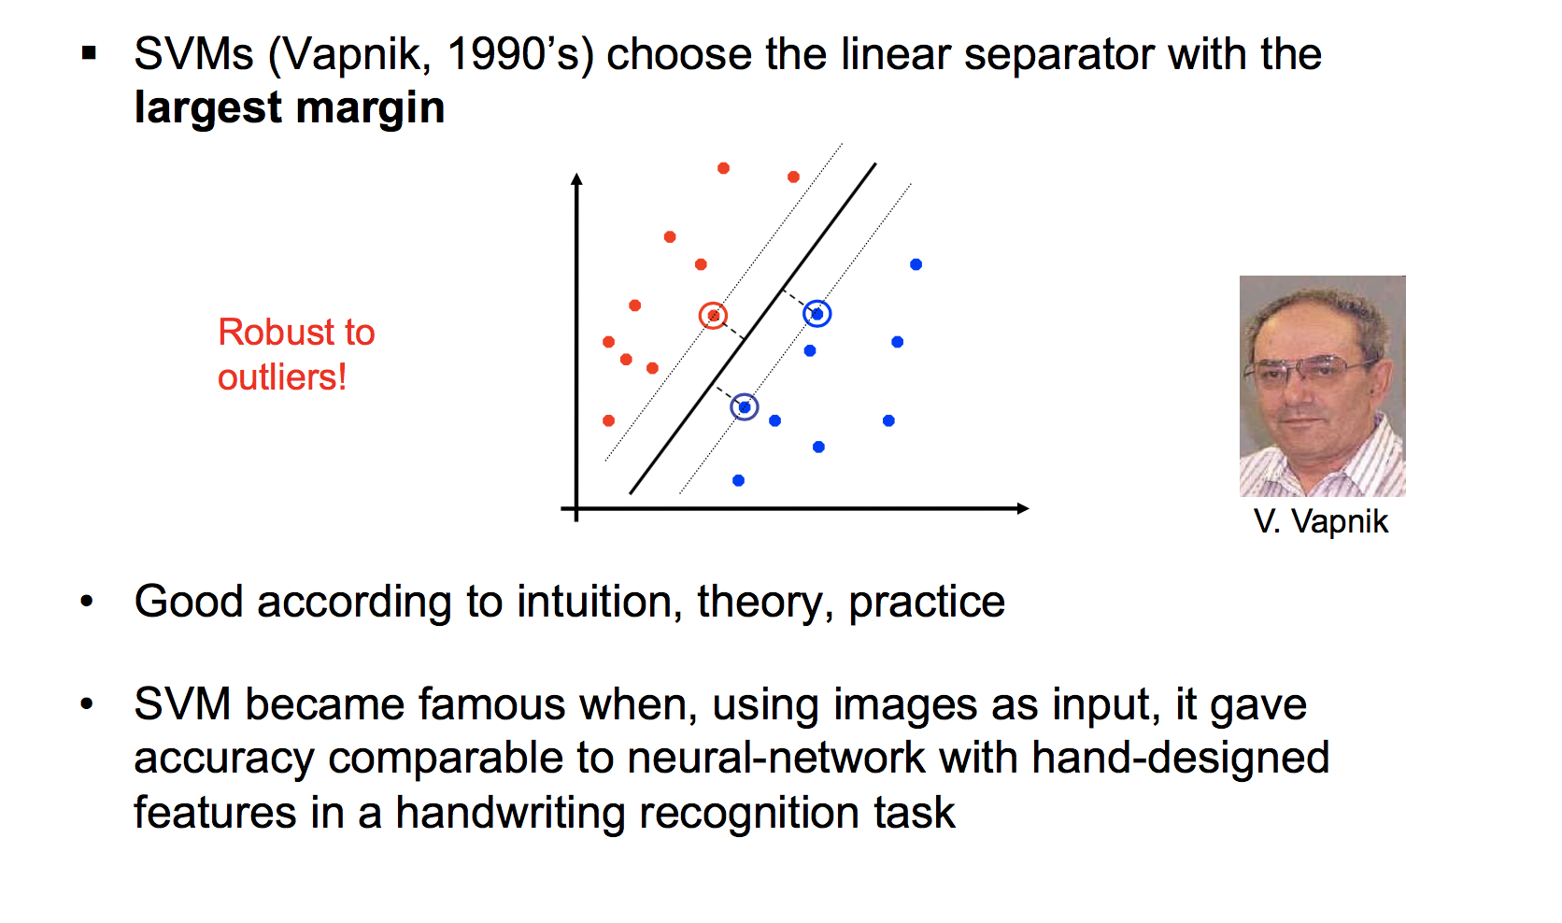
Support Vector Machines

Slide 12
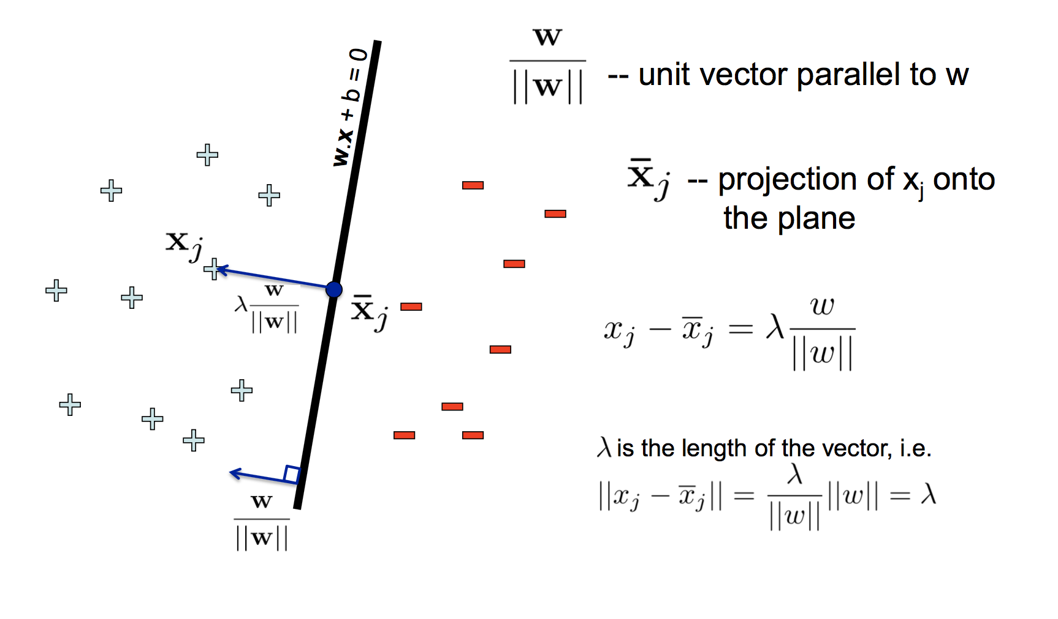
Normal to a plane

Slide 13
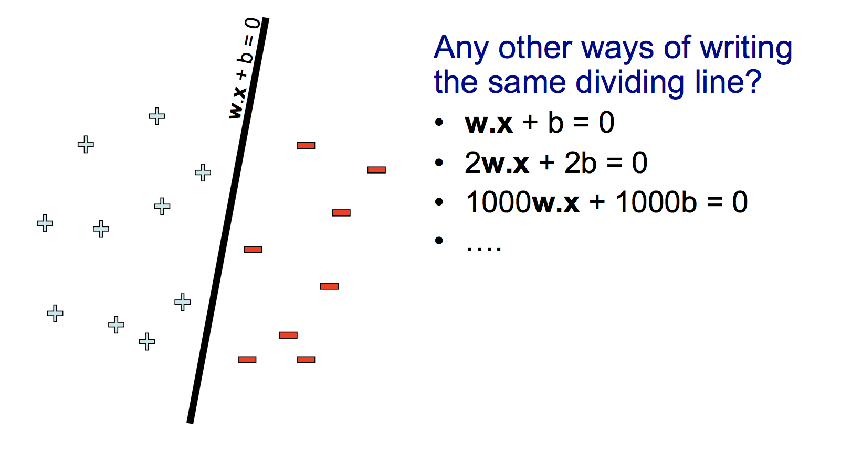
Scale invariance

Slide 14
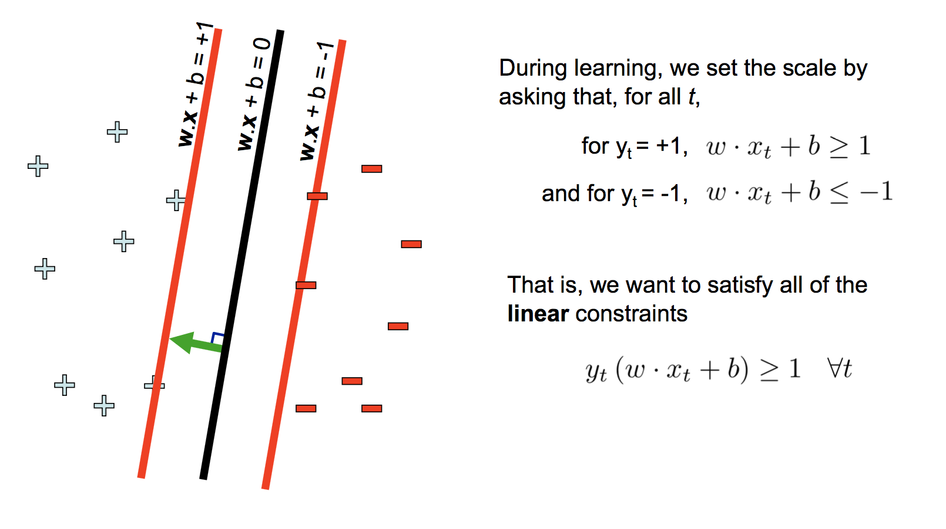
Scale invariance

Slide 15
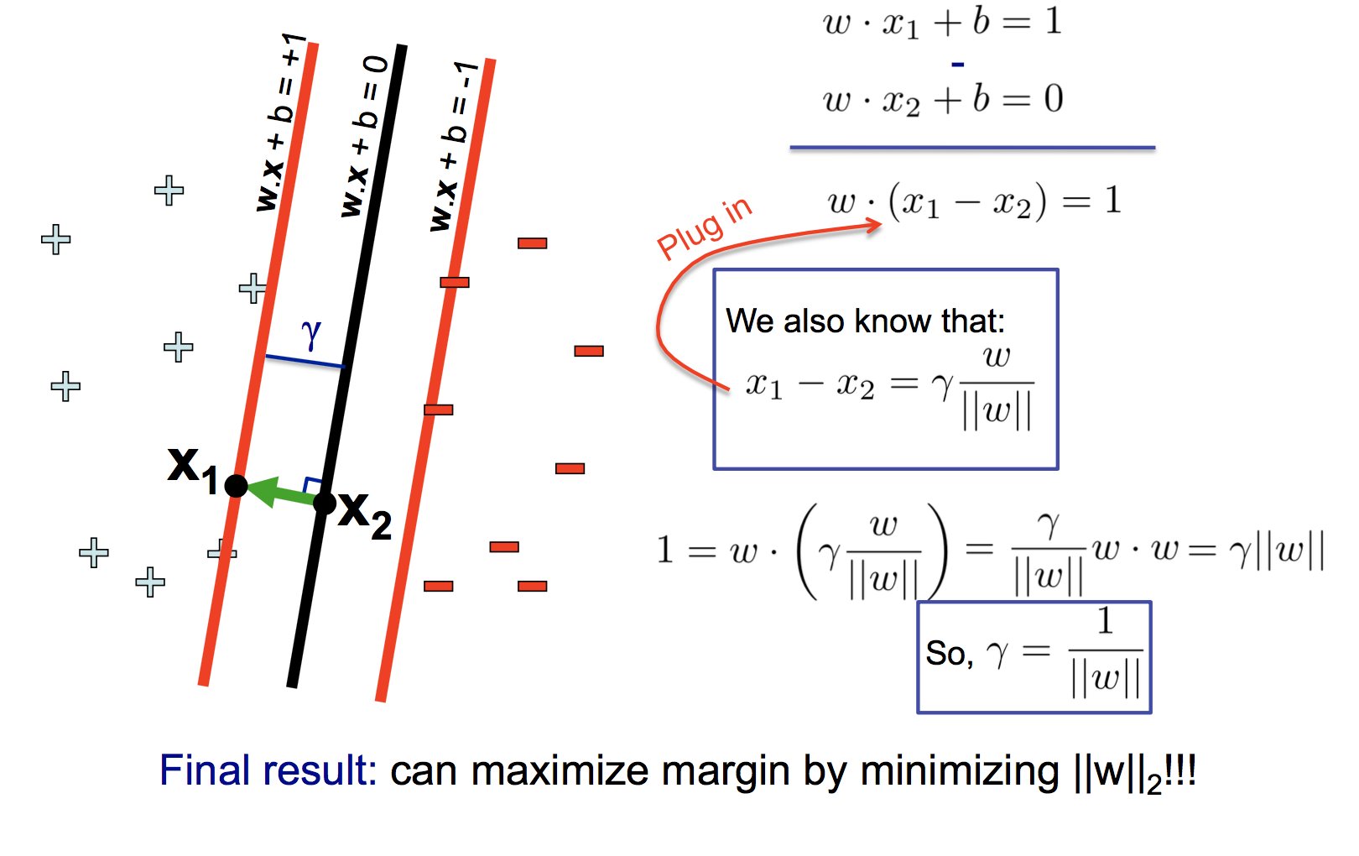
What is γ as a function of w?

Slide 16
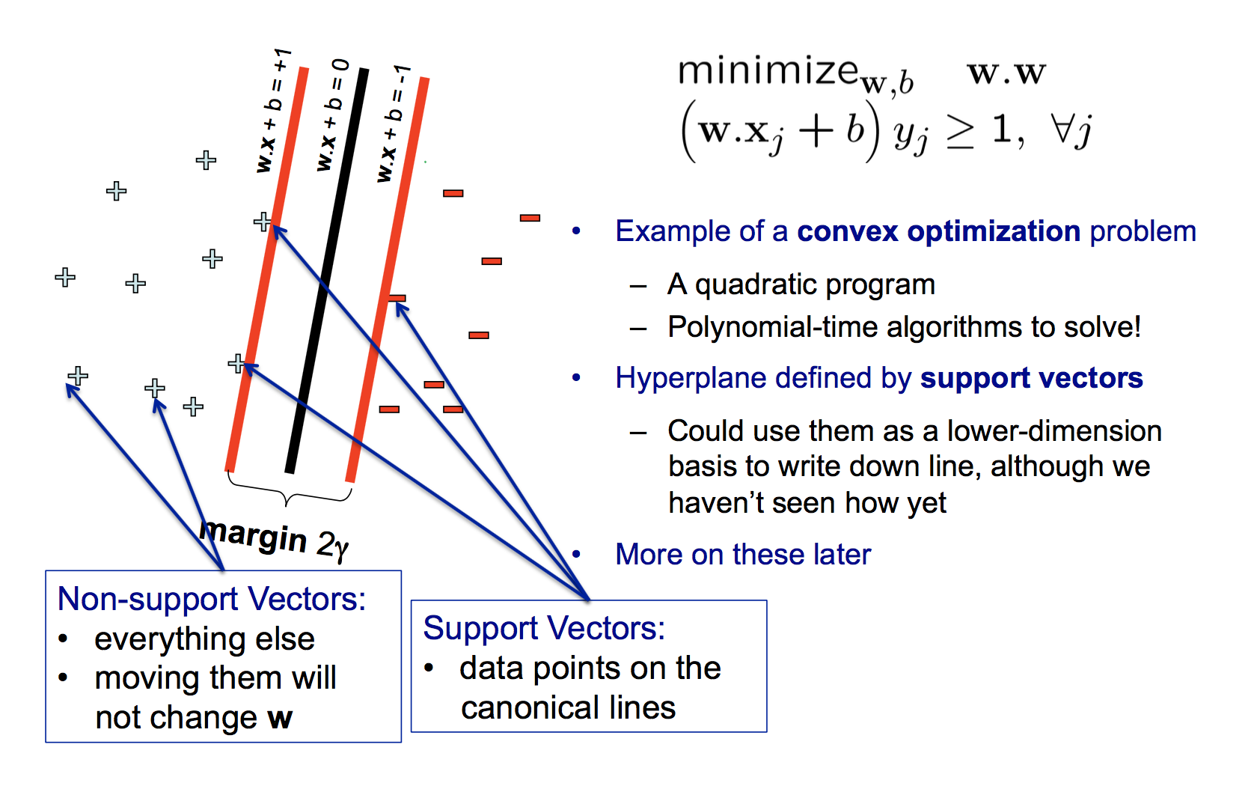
Support Vector Machines (SVMs)

Slide 17
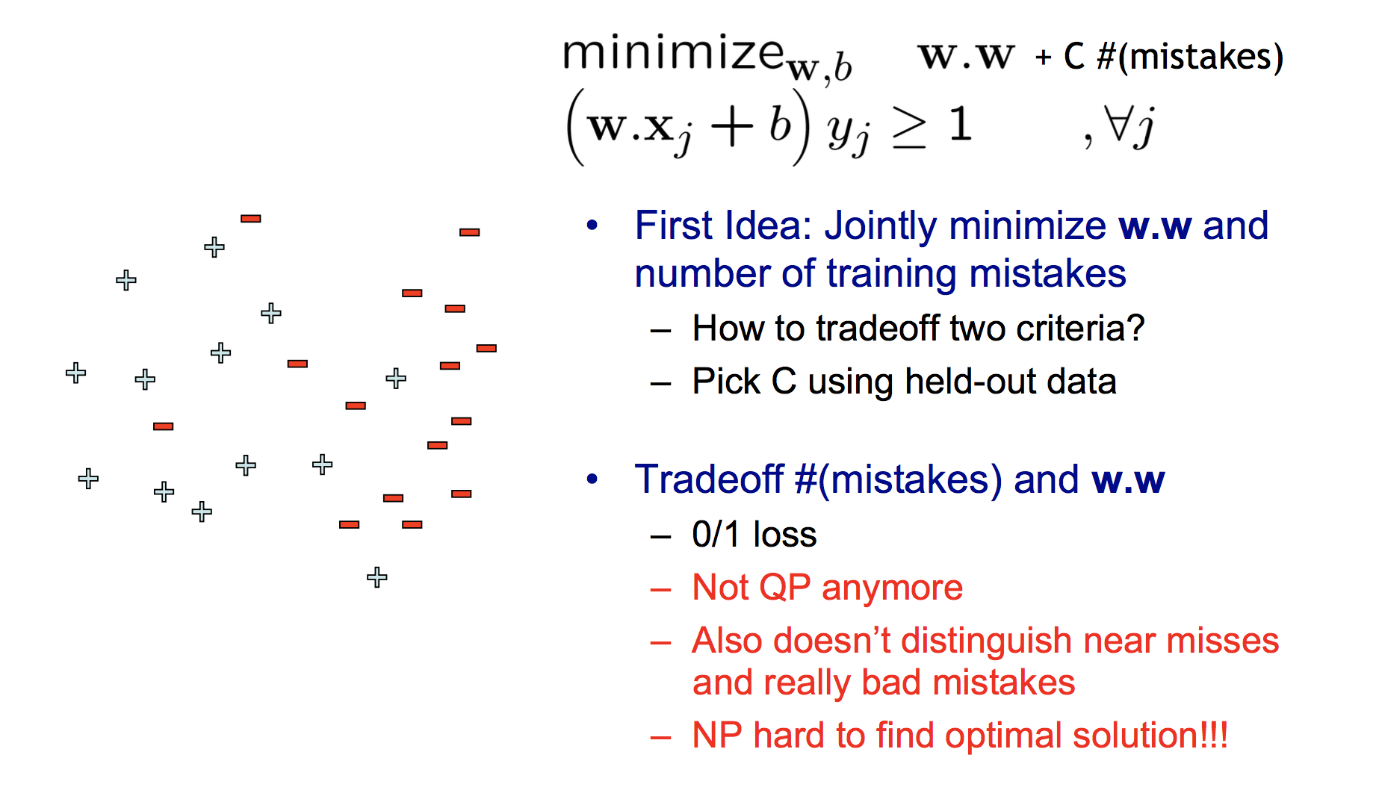
What if the data is not separable?

Slide 18
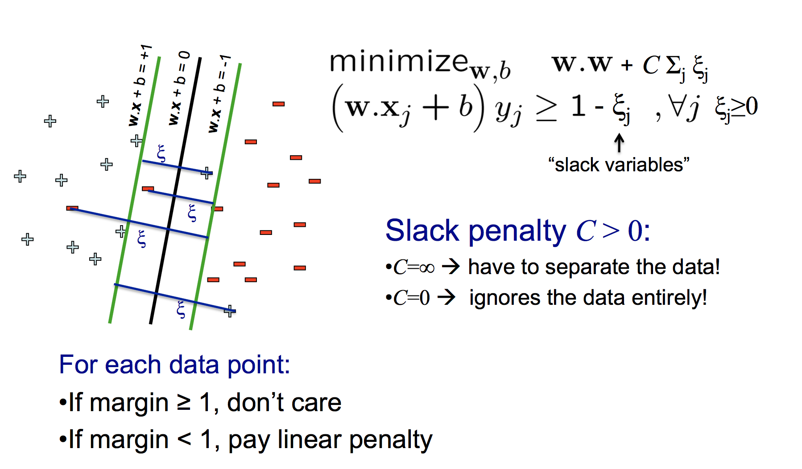
Allowing for slack: “Soft margin” SVM

Slide 19
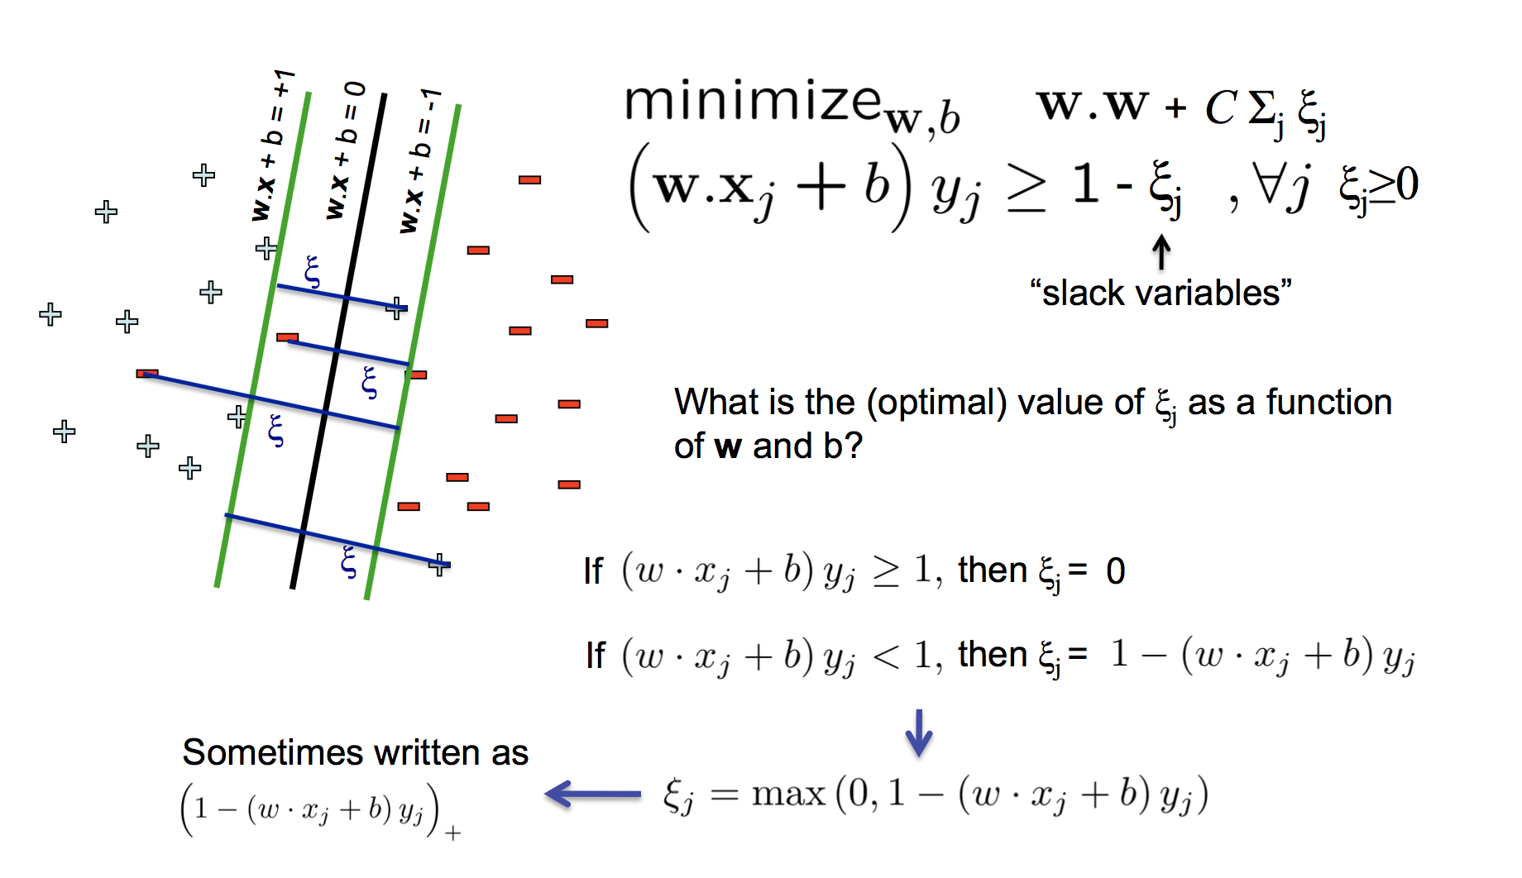
Allowing for slack: “Soft margin” SVM

Slide 20
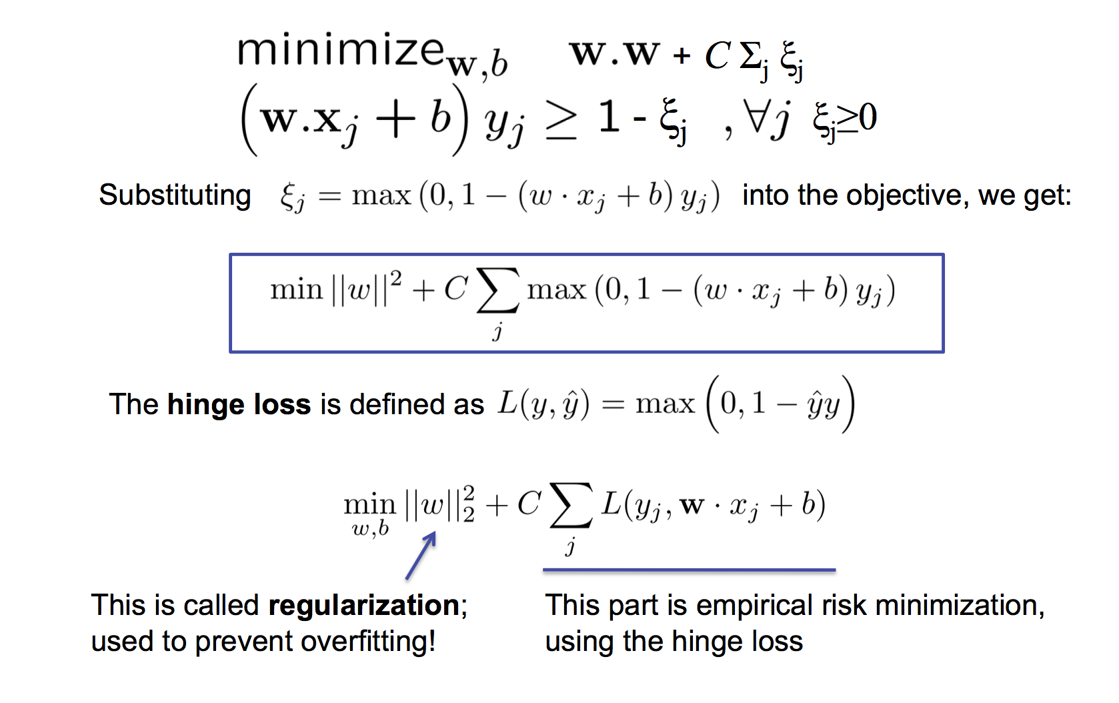
Equivalent Hinge Loss Formulation

Slide 21
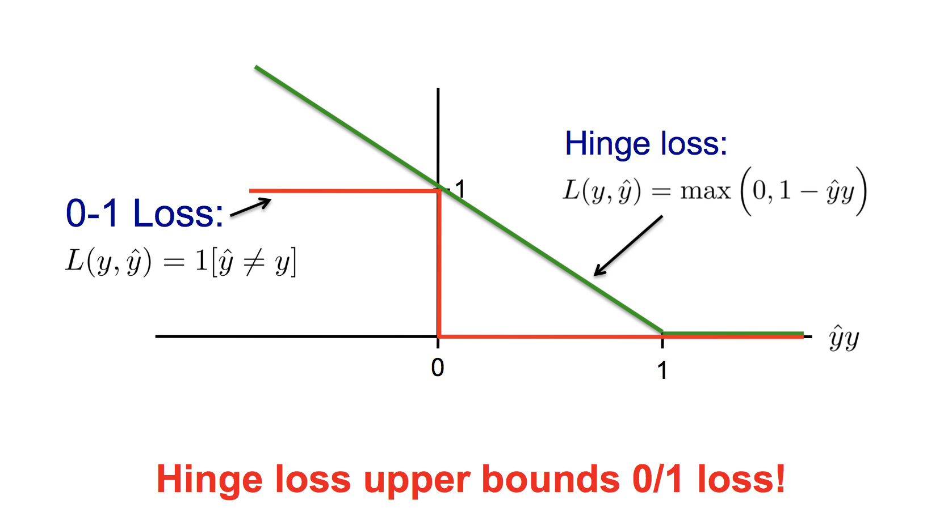
Hinge Loss vs 0-1 Loss

Slide 22
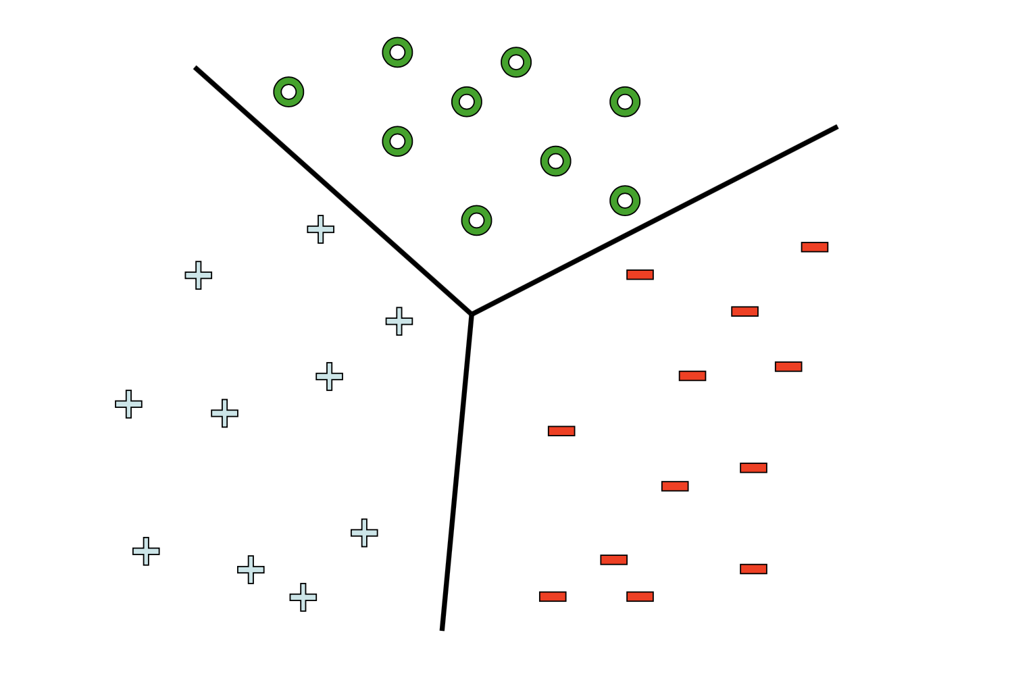
Multiclass SVM

Slide 23
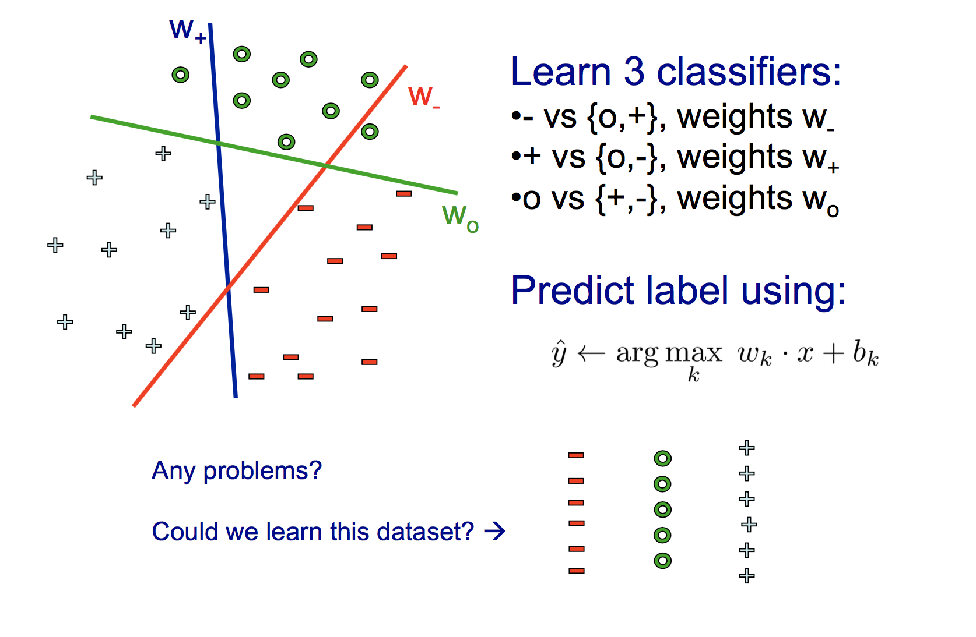
One versus all classification

Slide 24
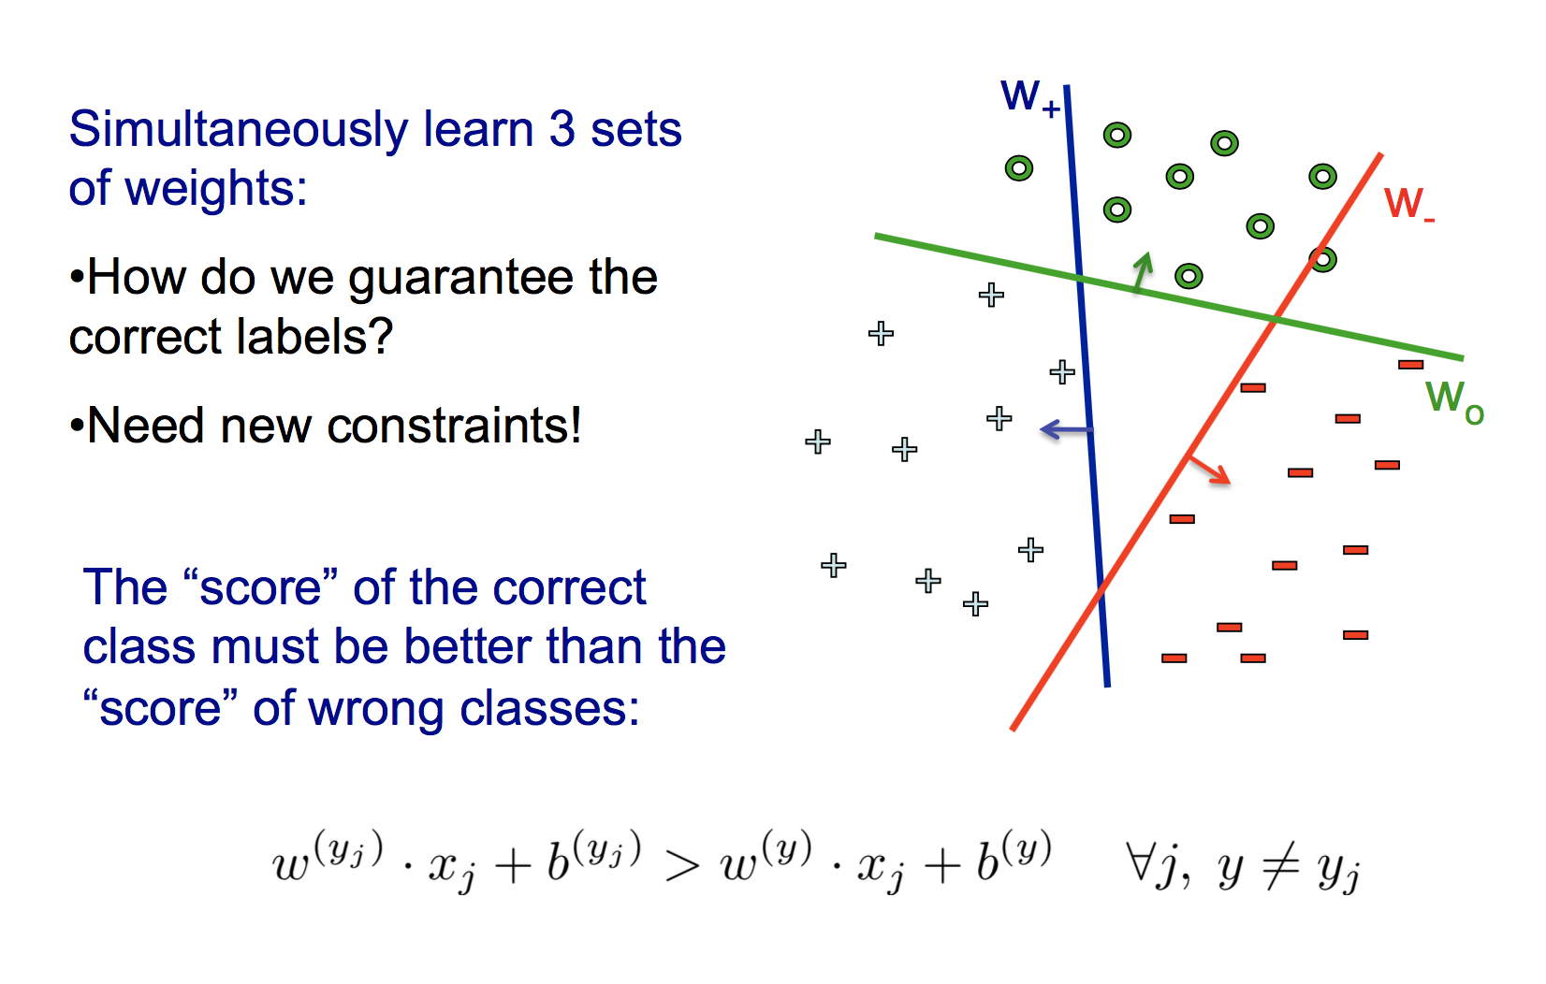
Multiclass SVM

Slide 25
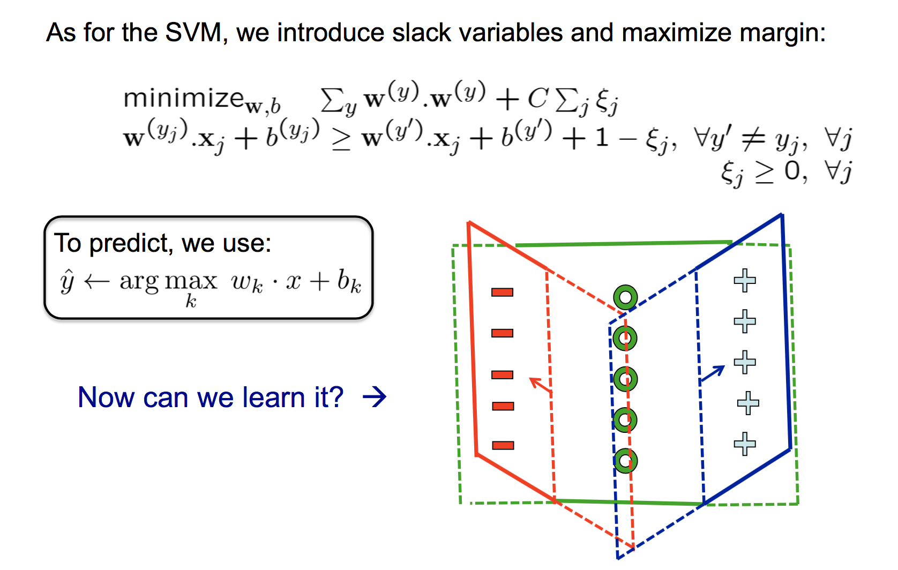
Multiclass SVM

Slide 26
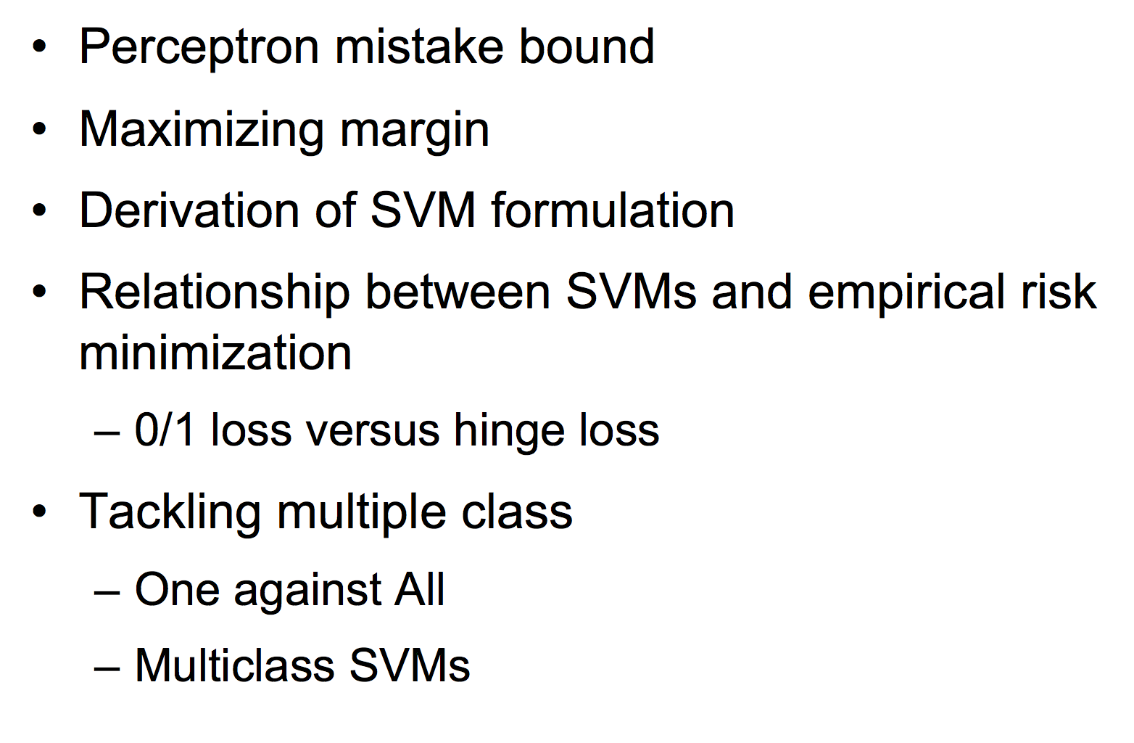
What you need to know

